Slide 1
Value-Returning Functions
Chapter 9

Slide 2
Chapter 9 Topics
Program-defined functions
Methods for defining program-defined functions
Value-Returning Functions
Variable scope and lifetimes
Passing Information
Square Root and Random numbers

Slide 3
Objectives
SQRT function
Generate Random Numbers
Create and Call a function that returns a Value
Pass information by value to a function
Write a function prototype
Understand a variable’s scope and lifetime

Slide 4

Functions
A block of code that performs a task.
Every C++ program has at least one function called main.

Slide 5
2 Reasons for Functions
To avoid duplicating code
Breaks large programs to be broken down into small, manageable tasks

Slide 6
Functions are:
Value-returning or
Void functions

Slide 7
How? Value-returning Functions
After the task is complete, returns precisely one value.
Are sometimes built-in:
pow
toupper
tolower
Others are created by the programmer
main

Slide 8
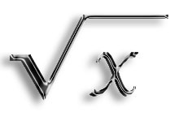
Square Root
#include <cmath>
sqrt(x)
X must be float or double
X is an argument

Slide 9
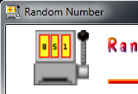
Random Integers
rand() function
Produces a random number (integer) that is greater than or equal to zero, but
Less than or equal to the value of RAND_MAX.

Slide 10
RAND_MAX
RAND_MAX is a constant defined in the library file.
Usually has a value of at least 32,767.

Slide 11
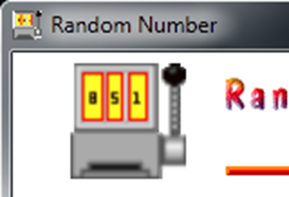
Random Numbers
Seed (initialize) the random number generator
Otherwise, you will get the same series of numbers each time the program is executed.
srand() function
srand(int time())

Slide 12
srand() function
In the cstdlib library file
#include <cstdlib>
Time function is in the ctime library file
#include <ctime>
The time function returns the number of seconds that have elapsed since midnight of January 1, 1970.

Slide 13
srand()
Used to generate a set of integers within a given range:
lowerbound + rand() % (upperbound – lowerbound +1)

Slide 14
Question 1
A block of code in C++ that performs a specific task is known as _____.

Slide 15
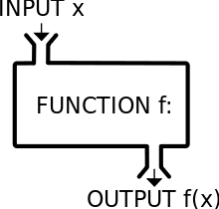
Answer 1
function

Slide 16
Question 2
_______ functions like main are written by the programmer.

Slide 17
Answer 2
Program-defined

Slide 18
Question 3
Functions are either void or _____

Slide 19
Answer 3
Value-returning

Slide 20
Question 4
The built-in _______ function can be used to calculate the square root of a number.

Slide 21
Answer 4
sqrt

Slide 22
Question 5
The built-in _______function can be used to generate random integers within a specific range.

Slide 23
Answer 5
rand

Slide 24
Creating program-defined value-returning functions - Header
Code the function header
Defines the type of data the function will return
The name of the function
Operational parameters
returnDataType functionName ((parameterlist));

Slide 25
Creating program-defined value-returning functions - Body
Code the function body
Instructions for accomplishing the task
Opening and closing braces
Return statement
Return expression
Expression is the value the function returns to the statement that called it
Datatypes must agree

Slide 26
Question 6
Functions consist of two parts, a ________ and a ______.

Slide 27
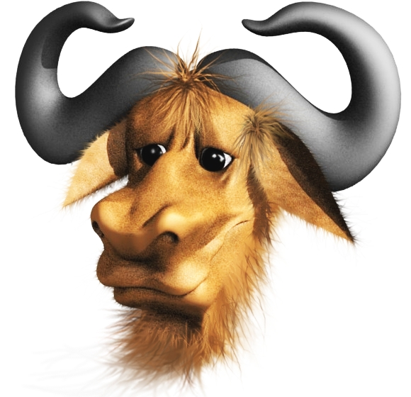
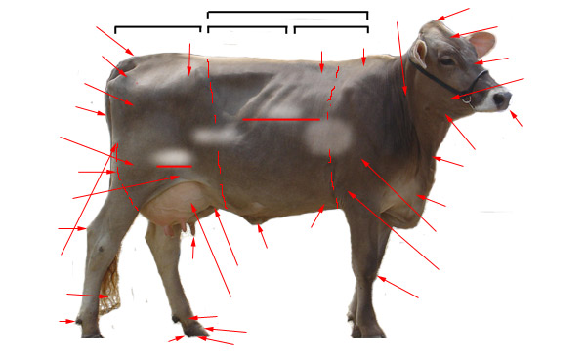
Answer 6
Header, body

Slide 28
Question 7
The optional parameterList in a function header represents the ________ of a function.

Slide 29
Answer 7
Formal arguments or formal parameters of the function. These are the items passed to the function so that it can perform the calculation.

Slide 30
Question 8
The _____ statement of a function returns a value to the calling function.

Slide 31

Answer 8
return

Slide 32
Question 9
The function ______ contains the instructions for the task the function is to perform.

Slide 33
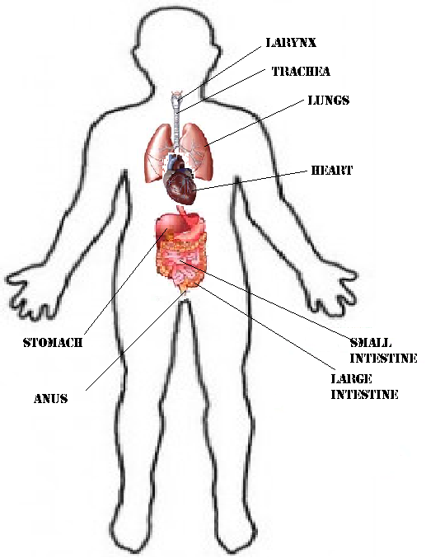
Answer 9
body

Slide 34
Question 10
The return data type of a function is contained in the function _______.

Slide 35
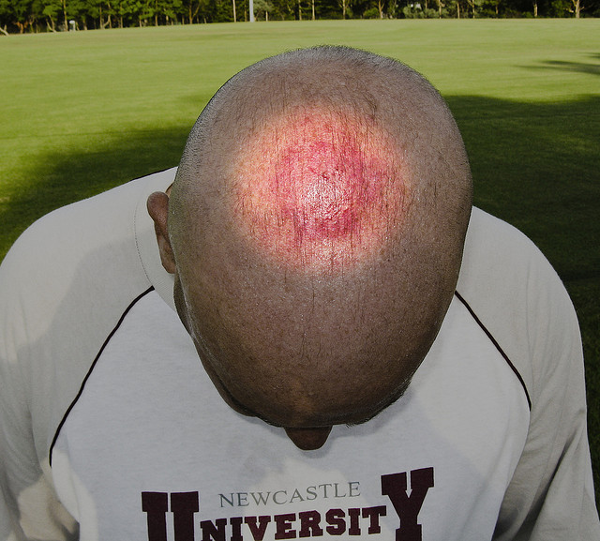
Answer 10
header

Slide 36
Calling a Function
In the function header:
Parameters or arguments
Plus datatypes
You have a relationship between actual and formal parameters
Number
Type
Order
Names

Slide 37
Parameters
Actual parameters can be passed to formal parameters as
Variables
Named constants
Literal constants
Keywords
Value

Slide 38
Function Prototypes 1
Declares a function
Contains the datatype of the return value of the function
Name of the function
The data type of each of the formal parameters

Slide 39
Function Prototypes 2
Alerts the compiler that the function will be defined in its entirety later in the program
Function is declared before it is called.
Ends with a semicolon
The function header does not end with a semicolon

Slide 40
Question 11
Another term for calling a function is _______ a function.

Slide 41
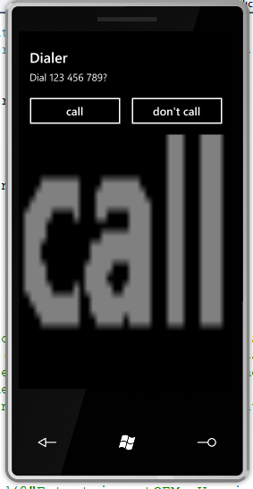
Answer 11
invoking

Slide 42
Question 12
The information items passed to a function are called its _______.

Slide 43
Answer 12
Actual arguments or actual parameters

Slide 44
Question 13
Passing a variable’s address to a function is referred to as passing by _______.

Slide 45
Answer 13
reference

Slide 46
Question 14
Unless otherwise specified, variables in C++ are automatically passed by _______.

Slide 47
Answer 14
value

Slide 48
Question 15
A function ________ is a statement that specifies the function’s name, return data type, and data types of its formal parameters.

Slide 49
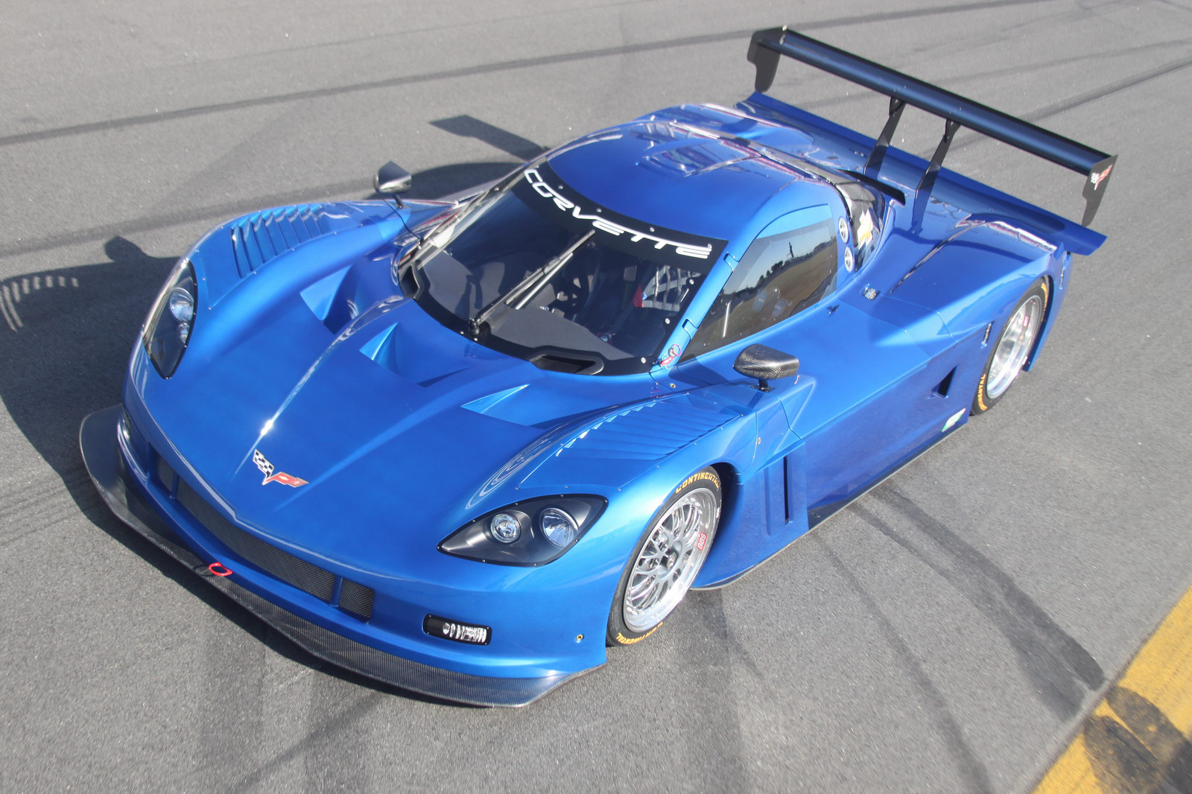
Answer 15
prototype

Slide 50
Scope and lifetime of a variable
Scope
Local
Global
Indicates the portion of a program that can used the variable
Lifetime
Indicates how long the variable will remain in memory

Slide 51

Local
Used only by the function in which they are declared
Remain in memory until the function ends
Makes the function portable (or stand-alone)
Could be included in the library for other programs to use

Slide 52

Global
Try to avoid using
Used anywhere in the program
Remain in memory until the program ends
Eliminates portability
Might require program modifications

Slide 53
Question 16
Variable’s _______indicated where in the program it can be used.

Slide 54
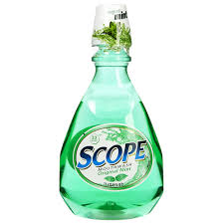
Answer 16
scope

Slide 55
Question 17
A variable’s ________ indicates how long the variable remains in the computer’s internal memory.

Slide 56

Answer 17
lifetime

Slide 57
Question 18
_______ variables can be used only by the function in which they are declared or in whose parameterList they appear.

Slide 58
Answer 18
local

Slide 59
Question 19
_____ variables are declared outside of any function in the program, and the remain in memory until the program ends.

Slide 60

Answer 19
global

Slide 61
Question 20
Declaring a variable as _______ can allow unintentional errors to occur.

Slide 62
Answer 20
global

